Slide 1
Class: IA-651 Predictive model for New York City Airbnb Open Data
Mohammad Panahazari
Date March 27, 2023

Slide 2
Agenda
Dataset Description
Data Preparation
Data Explanation
Predictions

Slide 3
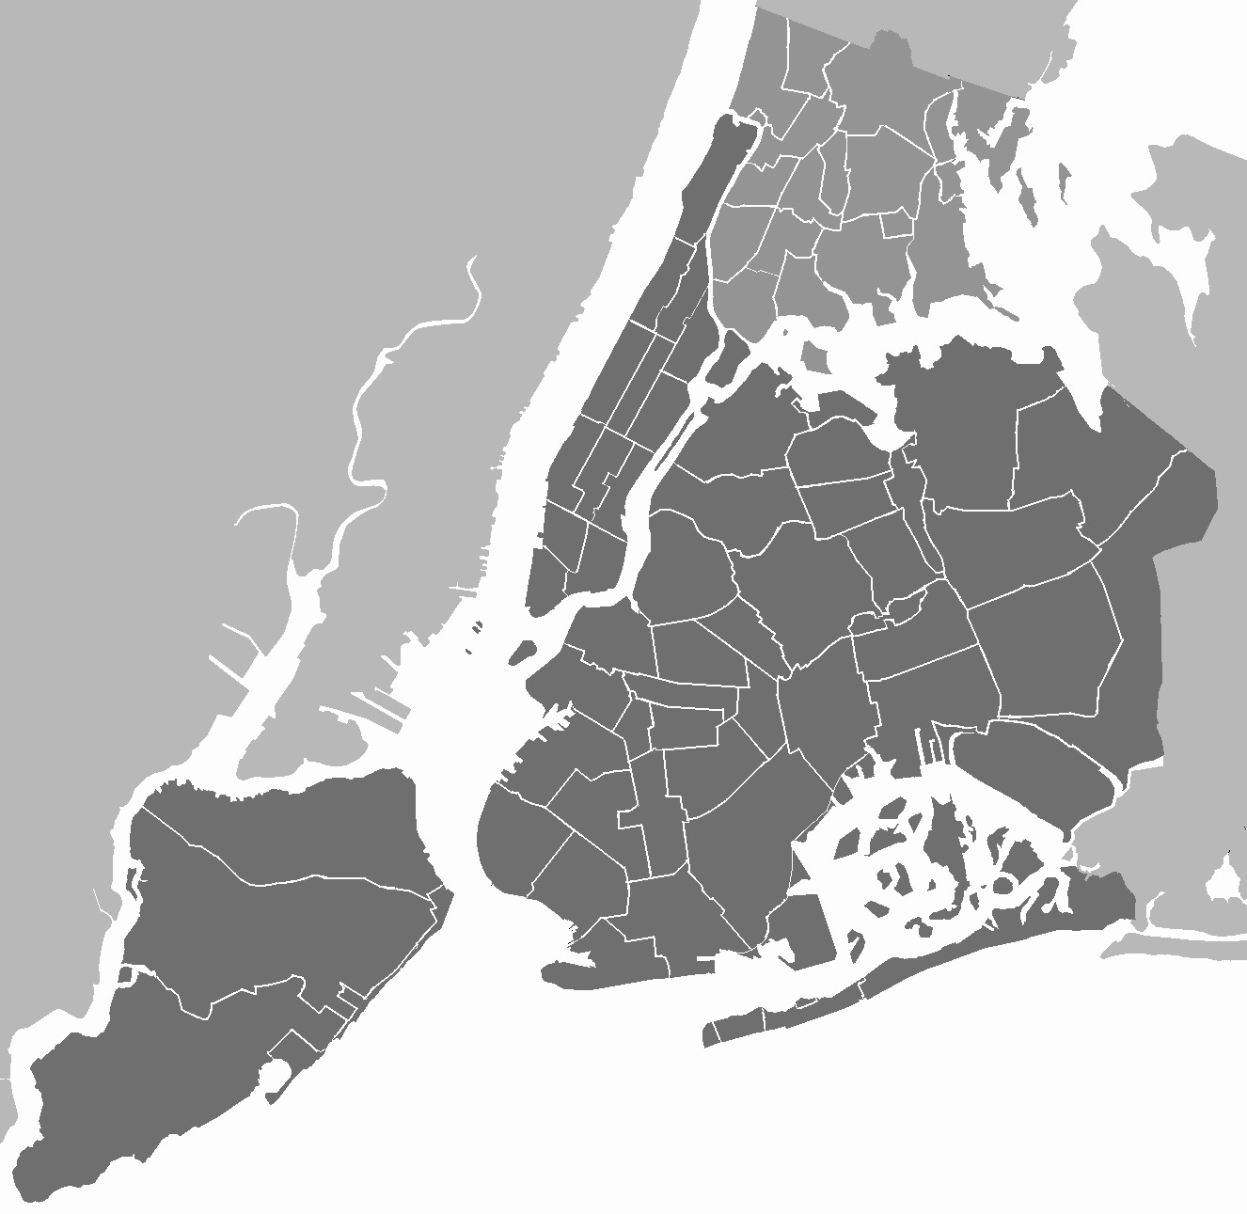
Dataset Description:
New York City Airbnb Open Data
Dataset shape: (48895, 16)
Features:
id int64
name object
host_id int64
host_name object
neighbourhood_group object
neighbourhood object
latitude float64
longitude float64
room_type object
price int64
minimum_nights int64
number_of_reviews int64
last_review object
reviews_per_month float64
calculated_host_listings_count int64
availability_365 int64

Slide 4
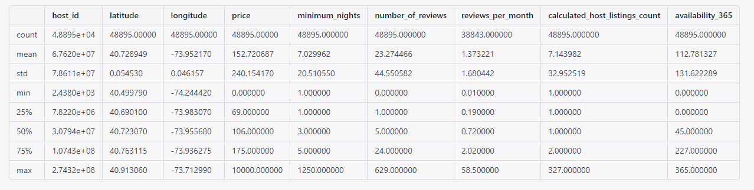
Dataset Description:
Null Values Status:
id 0
name 16
host_id 0
host_name 21
neighbourhood_group 0
neighbourhood 0
latitude 0
longitude 0
room_type 0
price 0
minimum_nights 0
number_of_reviews 0
last_review 10052
reviews_per_month 10052
calculated_host_listings_count 0
availability_365 0

Slide 5
Possible Predictions:
Predict the rental price based on other features such as the neighborhood, room type, and availability
Predict the occupancy rate based on other features such as neighborhood, and room type
Predict popular neighborhoods based on historical data, number of comments, occupied days

